Slide 1
CS5542 Big Data Analytics and Applications Tutorial 3 Linear Regression, Clustering
And
Video Annotation
February 1st ,2018
UMKC

Slide 2
Regression
Statistical process for estimating the relationships among variables
Dependence of one variable (dependent variable), on one or more variables (explanatory variable)
Predict the average value of the dependent variables in terms of the known or fixed values of the independent variables
Predict the value of dependent variable for a given value of the explanatory variable

Slide 3
Linear Regression Model
The parameters in the linear regression model are very easy to interpret.
β₀ is the intercept (i.e. the average value for Y if all the X’s are zero), β_{j} is the slope for the jth variable X_{j}
β_{j} is the average increase in Y when X_{j} is increased by one and all other X’s are held constant.
Y is a quantitative variable

Slide 4
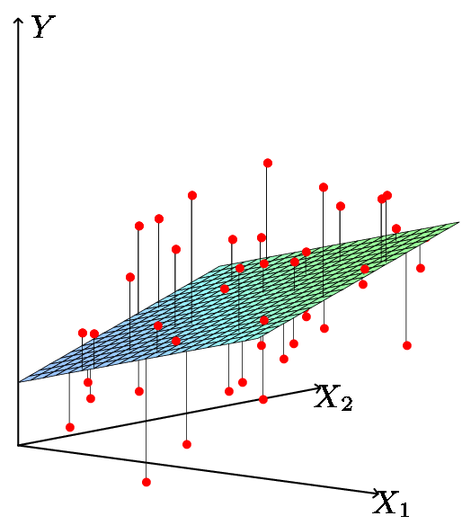
Least Squares Fit
We estimate the parameters using least squares i.e. minimize

Slide 5
Inference in Regression
Estimated (least squares) line.
The regression line from the sample is not the regression line from the population.
What we want to do:
Assess how well the line describes the plot.
Guess the slope of the population line.
Guess what value Y would take for a given X value
14
12
10
8
6
4
2
0
-10
-5
0
5
10
X
True (population) line. Unobserved

Slide 6
Spark – Available Regression models
Linear Least squares
Lasso
Ridge Regression
Decision trees
Random Forests
Gradient Boosted Trees
Isotonic Regression

Slide 7
Linear Regression
Read data
Generate training and test data
Build model
Evaluate training error
Evaluate test error
Save and load model

Slide 8
Linear Regression: Input Data
One Dependent variable and 8 independent variables
Sample data point

Slide 9
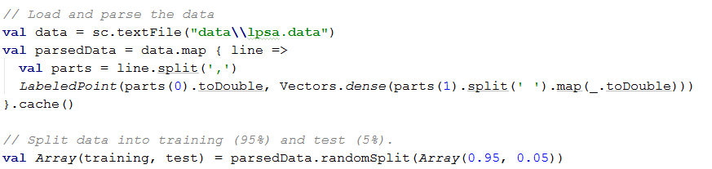
Load and parse data
Labeled point data is needed for supervised learning
A labeled point is a local vector, either dense or sparse, associated with a label/response.
Split parsed data to get training and test data

Slide 10
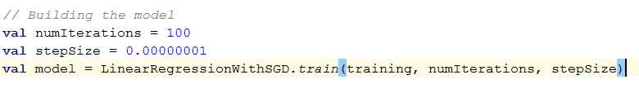
Build Model
Linear regression with stochastic gradient descent
With parameters number of iterations, step size, data

Slide 11
Stochastic Gradient Descent
Using small batches of random data (stochastic training)
In this case, stochastic gradient descent
Ideally we should use all data but expensive
Instead we use a different subset every time
Cheap and same benefit

Slide 12
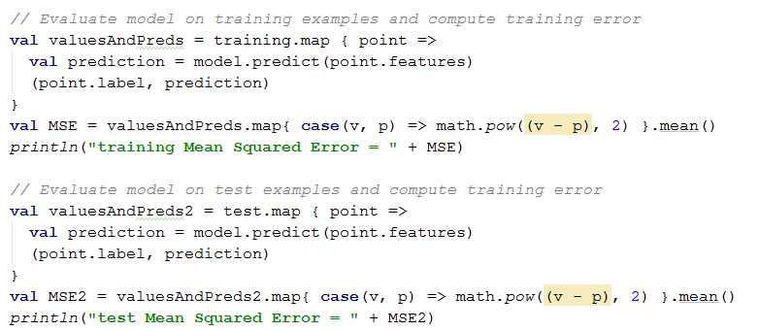
Linear Regression: Evaluation/Output
Training and test error. Training error is usually less than test error.
Training error under estimates test error or actual model error

Slide 13
Save and Load Model
Save the model to disk
Use the saved model for inference

Slide 14
Clustering/Cluster Analysis
Unsupervised learning
No labels
Task of grouping a set of objects in such a way that objects in the same group (called a cluster) are more similar to each other than to those in other clusters
Clustering algorithms rely on a distance metric between data points
Minimize inter-class similarity and maximize intra-class similarity

Slide 15
Spark MLlib package
K-Means
Gaussian Mixture
Power Iteration Clustering (PIC)
Latent Dirichlet Allocation (LDA)
Bisecting k-means
Streaming k-means

Slide 16
K-Means Clustering
“K” stands for number of clusters, it is typically a user input to the algorithm; some criteria can be used to automatically estimate K
iterative in nature
It converges, however only a local minimum is obtained

Slide 17
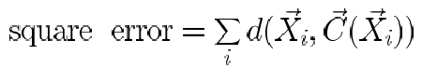
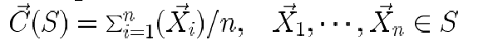
Partitioning: K-Means Clustering
Basic Idea (MacQueen’67):
Partitioning (k cluster center means to represent k cluster and assigning objects to the closest cluster center) where k is given
Similarity measure using Euclidian distance
Goal:
Minimize squared error
where C(X_{i}) is the closest center to X_{i} and d is the squared Euclidean distances between each element in the cluster and the closest center
Algorithm:
Step 1: Select an initial partition of k clusters
Step 2: Assign each object to the cluster with the closest center
Step 3: Compute the new centers of the clusters
Step 4: Repeat Step 2 and until no object changes cluster

Slide 18
The K-Means Clustering Method
Example
10
10
9
9
8
8
7
7
6
6
5
5
4
Assign each objects to most similar center
Update the cluster means
4
3
3
2
2
1
1
0
0
0
1
2
3
4
5
6
7
8
9
10
0
1
2
3
4
5
6
7
8
9
10
reassign
reassign
K=2
Arbitrarily choose K object as initial cluster center
Update the cluster means

Slide 19
K-Means Clustering
Read data
Generate training and test data
Build model
Evaluate training error
Evaluate test error
Save and load model

Slide 20
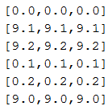
K-Means Clustering: Input Data
3 Dimensions
By observing data we can choose K to be 2

Slide 21
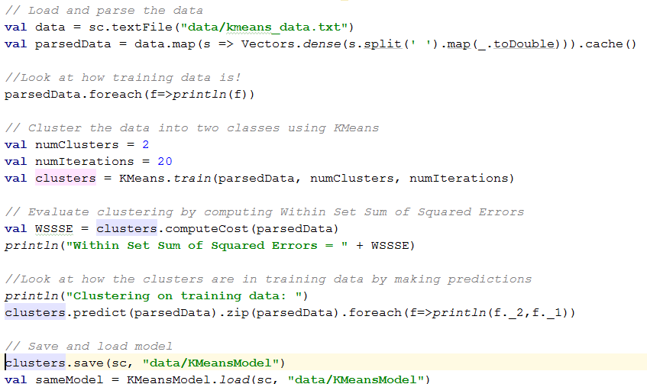
K-Means Clustering: Code

Slide 22
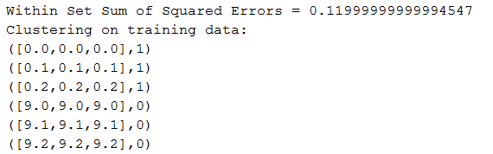
K-means Clustering: Output (k=2)

Slide 23
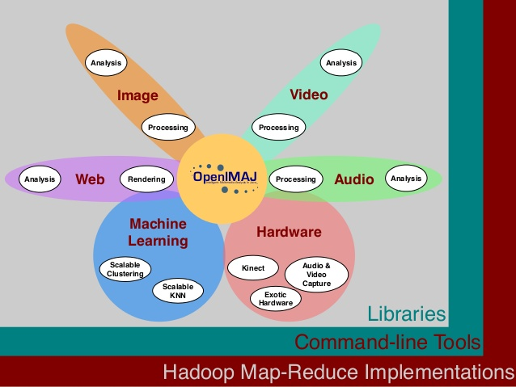
OpenIMAJ
OpenIMAJ is a set of libraries and tools for multimedia content analysis and content generation.
state-of-the-art computer vision (e.g. SIFT descriptors, salient region detection, face detection, etc.)
advanced data clustering,
performs analysis on the content, layout and structure of webpages.
http://openimaj.org/

Slide 24
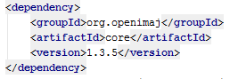
OpenIMAJ
Library for multimedia content analysis
http://openimaj.org/tutorial/index.html

Slide 25
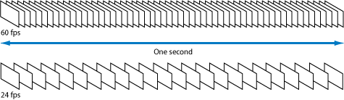
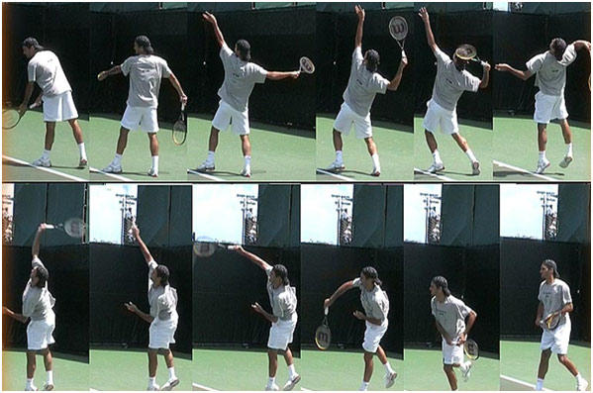
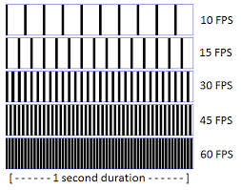
Frames

Slide 26
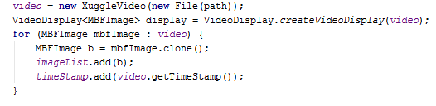
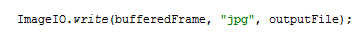
Frames Extraction
Iterating over Video Frames

Slide 27
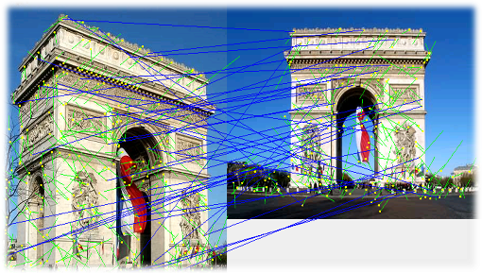
SIFT – Scale Invariant Feature Transform
Addresses the problem of matching features with changing scale and rotation
Very successful; experiments have shown it is one of the best approaches for feature matching
Widely used for recognizing objects from image databases matching

Slide 28
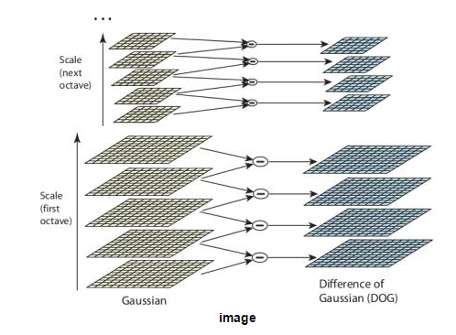
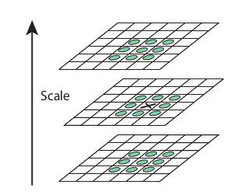
SIFT – Scale Invariant Feature Transform
Scale-space Extrema Detection

Slide 29
SIFT – Scale Invariant Feature Transform
Keypoint Localization
Once potential keypoints locations are found, they have to be refined to get more accurate results
They used Taylor series expansion of scale space to get more accurate location of extrema, and if the intensity at this extrema is less than a threshold value (0.03 as per the paper), it is rejected.
Orientation Assignment
An orientation is assigned to each keypoint to achieve invariance to image rotation

Slide 30
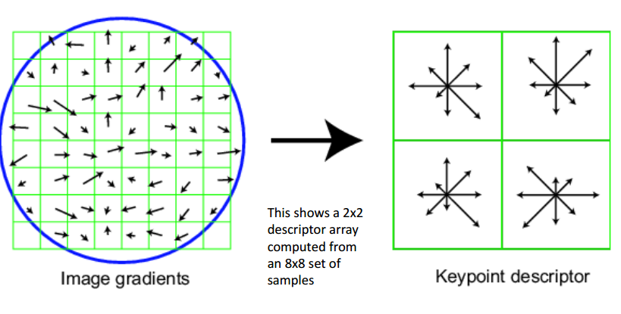
SIFT – Scale Invariant Feature Transform
Keypoint Descriptor
A 16x16 neighbourhood around the keypoint is taken. It is divided into 16 sub-blocks of 4x4 size. For each sub-block, 8 bin orientation histogram is created. So a total of 128 bin values are available. It is represented as a vector to form keypoint descriptor

Slide 31
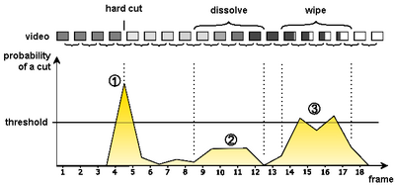
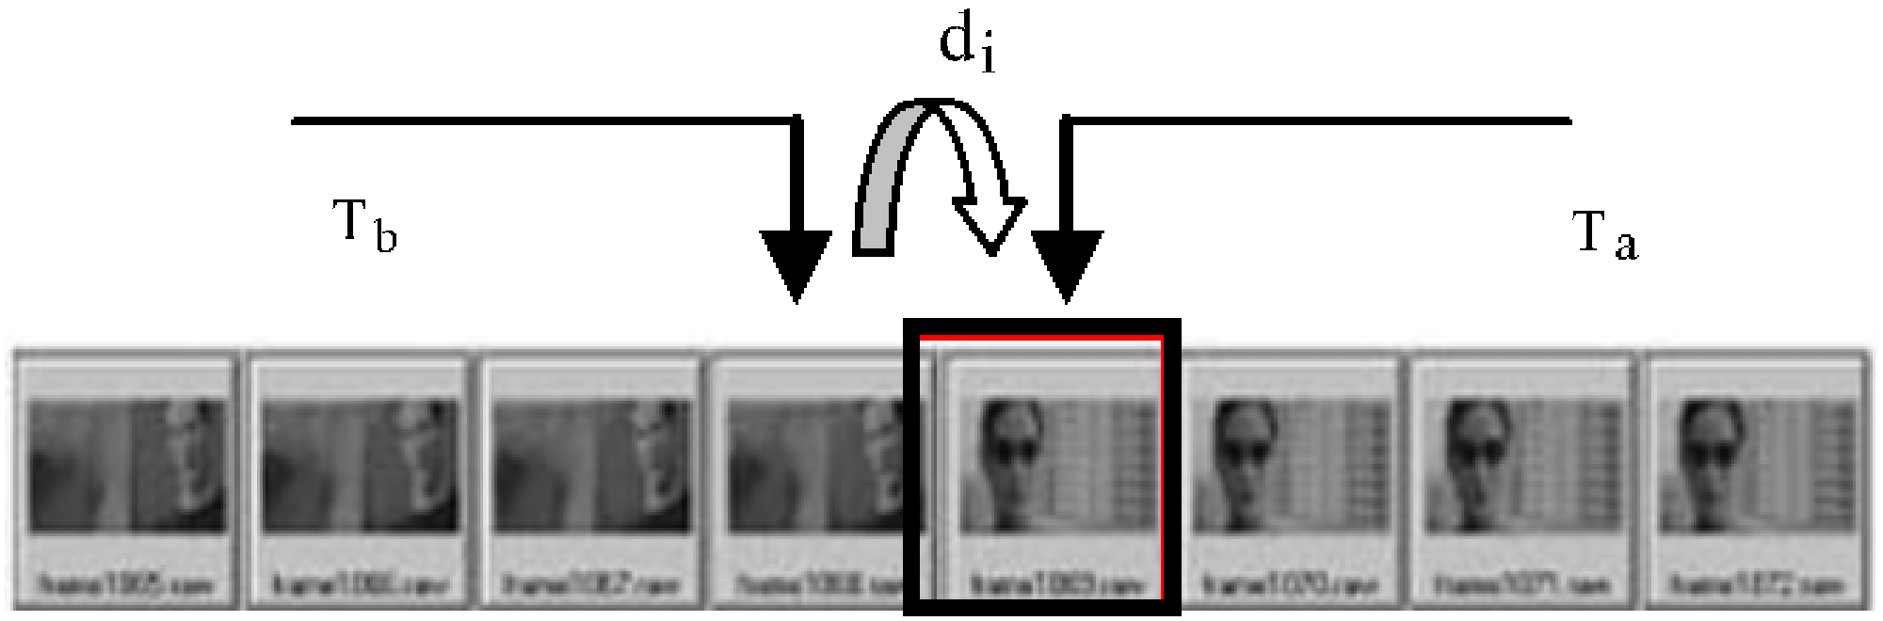
Shot Transition Detection
Shot transition detection (shot detection also called cut detection)
The automated detection of transitions between shots in digital video with the purpose of temporal segmentation of videos.
Compute the threshold based on image features such as SIFT

Slide 32
Shot Transition Detection
Comparing the SIFT features with adjacent images
If common features are less than Threshold, it is shot transition
Retrieving SIFT Key points in the image

Slide 33
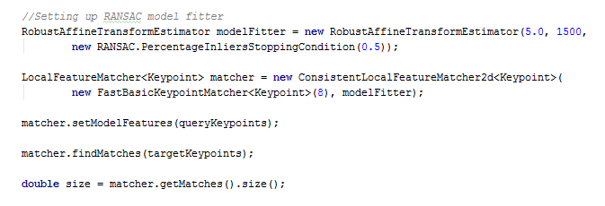
Key Frame Detection (Shot Transition)

Slide 34
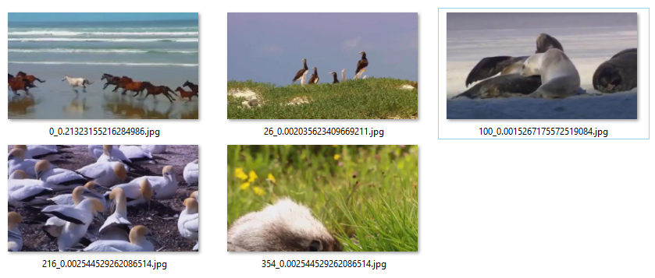
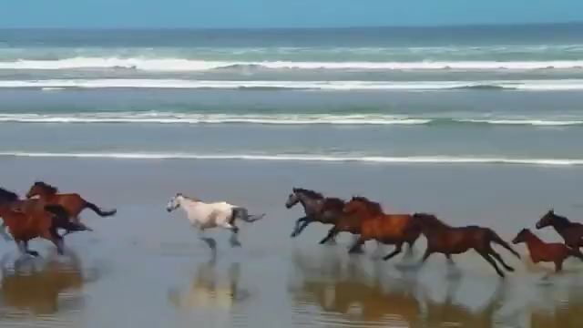
Shot Transition Detection (Key Frames)
Original Video
Key Frames Detected

Slide 35
Maven Dependency
<dependency> <groupId>com.clarifai.clarifai-api2</groupId> <artifactId>core</artifactId> <version>2.1.0</version> </dependency>

Slide 36
CLARIFAI API
The Clarifai API offers image and video recognition as a service. Whether you have one image or billions, you are only steps away from using artificial intelligence to recognize your visual content.
The API is built around a simple idea. You send inputs (images) to the service and it returns predictions.
The type of prediction is based on what model you run the input through.

Slide 37
Models
Food
Travel
NSFW
Wedding

Slide 38
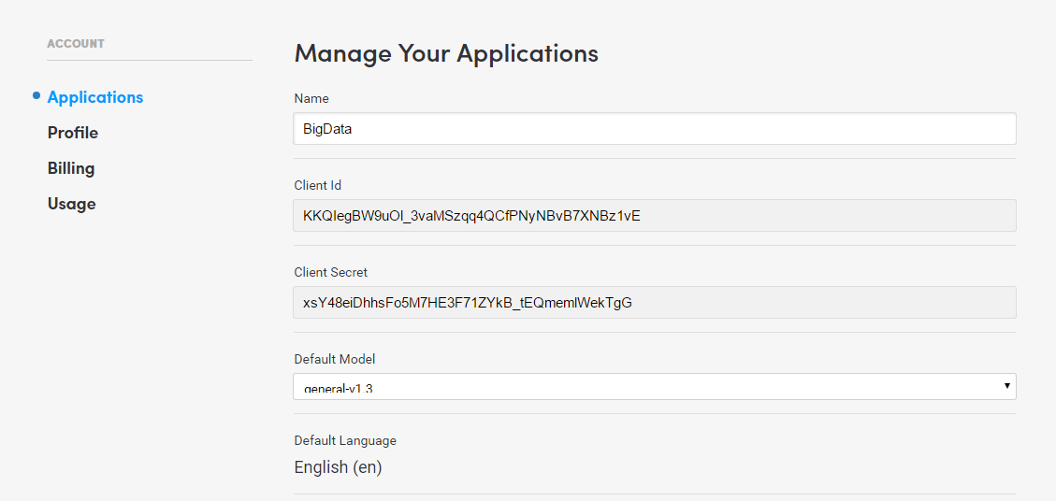
Application
Sign up at https://clarifai.com/
Create a new application Client ID & Secret https://developer.clarifai.com/account/applications/

Slide 39
Code
final ClarifaiClient client = new
ClarifaiBuilder("CLIENT_ID", "CLIENT_SECRET") .client(new OkHttpClient())
.buildSync(); ClarifaiResponse response = client.getDefaultModels().generalModel().predict() .withInputs(ClarifaiInput.forImage(ClarifaiImage.of(new
File("input/maxresdefault.jpg")))) .executeSync();

Slide 40
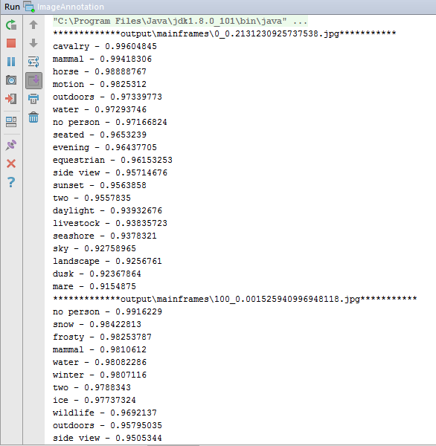
Output

Slide 41
